Slide 1


StreamWave Entertainment Content Strategy and Recommendation
Genre Performance Analysis and Retention Optimization
Presented by Collins Agyei
This Photo by Unknown Author is licensed under CC BY-SA

Slide 2

Business Problem
StreamWave faces challenges in understanding viewer engagement, content performance, and subscriber retention across different streaming genres. The platform needs to identify;
High subscriber churn and retention challenges
Difficulty identifying high-performing genres
Weak alignment between content and viewer preferences
Need for data-driven content investment decisions

Slide 3

Business Objectives
Identify high-performing content genres
Improve subscriber retention and reduce churn
Understand viewer preferences and engagement behavior
Support data-driven content strategy and investment decisions

Slide 4

Key Business Questions
Which genres generate the highest viewer engagement?
What factors contribute to subscriber churn and retention?
How do viewer preferences influence content performance?
How can data-driven insights improve content investment decisions?

Slide 5
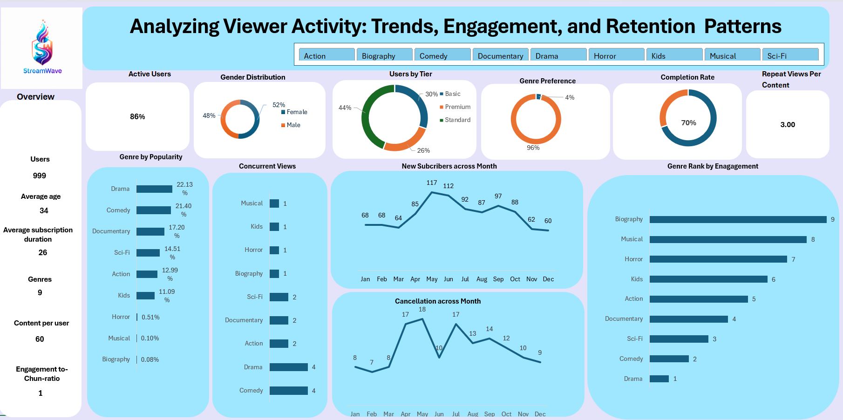
The dashboard provides an interactive overview of viewer behavior, engagement trends, subscriber growth, content performance, and retention patterns across streaming genres.

Slide 6
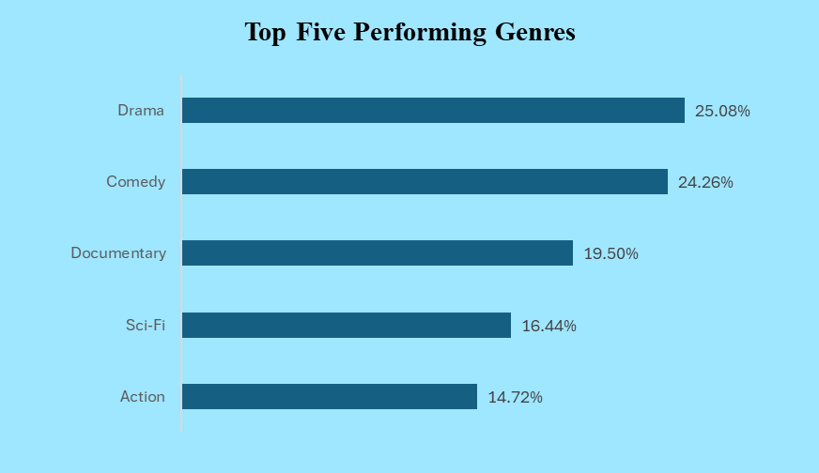
Analysis & Key Insights
High Performing Genres
Drama and Comedy are the top-performing genres
High-engagement genres drive stronger retention
Low-performing genres require content improvement

Slide 7
Analysis & Key Insights
Subscriber Growth & Retention Trends
Subscriber growth peaked between May and September
Cancellation rates increased during high-growth periods
Growth alone did not guarantee subscriber retention
Strong engagement strategies are needed to reduce churn

Slide 8
Analysis & Key Insights
Viewer Engagement & Content Performance
Biography and Musical showed the highest engagement scores
Drama and Comedy recorded lower engagement rankings
Viewer engagement differs significantly across genres

Slide 9
Core Engagement KPIs
Completion Rate - Content completion behaviour
Repeat - Viewer rewatch activity
Genre Engagement Rank - Top engaging genres
Active User Rate - Platform activity level
These KPIs were used to evaluate viewer engagement, content interaction, and subscriber retention performance across genres.
High engagement genres should receive greater content investment
Low engagement categories may require content improvement strategies
Strong completion rates indicate positive viewer interaction
Repeat viewing behavior suggests stronger audience loyalty
Active user trends should be monitored to support retention performance

Slide 10

Key Takeaways
Drama & Comedy dominated popularity and attracted the highest viewer interest
Biography achieved the strongest engagement despite lower overall popularity
Subscriber growth increased significantly during mid-year periods
Cancellation trends fluctuated during high acquisition periods
Strong completion and repeat viewing behavior reflected positive audience interaction
Low-engagement genres may require content improvement and targeted promotion strategies
Viewer engagement insights can support smarter content investment decisions

Slide 11

Business Recommendation
Increase investment in high-performing genres such as Drama and Comedy
Improve low-engagement genres through content redesign and targeted marketing
Strengthen retention strategies during high cancellation periods
Use engagement insights to personalize viewer recommendations
Focus on high-engagement content to improve subscriber loyalty
Continuously monitor engagement and churn trends to support content strategy

Slide 12

Conclusion
Viewer behavior and engagement patterns differed across streaming genres
Content performance strongly influenced subscriber interaction and viewing trends
Subscriber growth and cancellation trends revealed important retention challenges
Engagement-focused analysis provided valuable insights for strategic decision-making

